Slide 1
Differential expression analysis R/DESeq2
RNA-seq workshop
RSSCB 2019, March 4

Slide 2
Problem
How to determine which genes have different RNA levels in one condition compared to another?
How to differ between technical noise, biological variability and actual differential expression

Slide 3
Key steps in DEA
Preprocessing
Import data, structure and define metadata
Normalize data
Quality control
Differential expression analysis
Visualization
Try to understand what it means
From numbers to biology

Slide 4
Challenges
Few biological/technical replicates
Large dynamic range of RNA-seq count data
Biological variation
Sampling noise/Technical variation

Slide 5
Normalization
Different samples have different number of total reads
Scale on total reads in each cell
Scale on geometric mean of each sample
central tendency, less sensitive to outliers
Spike-in?
Different genes have different lengths (#base pairs in transcript)
RPKM = # Reads gene
# Total Reads in sample * length of gene in kb * 1e6
FPKM / TPM
Gene A: 30,000 bp
Gene B: 10,000 bp

Slide 6
Quality control
Before testing the data, check that things look as they should..
Equal fraction of reads mapping to protein-coding genes?
Look at expression of known marker genes
Dimensionality reduction (PCA, tSNE, UMAP..)
Finds dimensions in data with most variance
Hopefully most variance in the data is explained by your biological conditions
If not, almost impossible to work with data
Sample-to-sample distance
Pairwise comparison between each sample

Slide 7
Differential expression testing of RNA-seq data: Challenges
Large dynamic range of gene counts (0 -> 100,000++)
Very different nature of low counts vs high counts
(5,2,8 vs 5,15,16)
Sampling noise
(500,497,503 vs 500,510,511)
Biological noise (most dominant)
Variance of data depends on mean!
Variance = noise + biological variation
Small number of replicates ->
More sensitive to noise..
Expensive solution: Sequence deeper, more biological replicates

Slide 8
Easier solution: DESeq2
Information sharing: Use data from all genes and all samples to get better estimates of variance (removing noise)
For each gene, a new variance estimate will be calculated based on it’s expression
Use variances of all genes with similar expression levels

Slide 11
DESeq2: Key steps
Normalize data
Scale on geometric mean
Model data on Negative Binomial distribution
Better model for RNA-seq counts..
Fits a dispersion-mean trend
Use all information (all genes, all samples) to estimate expected variance of a gene with a given mean expression level
Shrinkage dispersion estimates
Use dispersion-mean trend to “correct” variances of a gene
Log-transformation for visualization / clustering of data
Shrinking together samples of low-count genes
Correct log2-fold change estimates
Use dispersion-mean trend to “correct” fold changes between conditions
Test for differential expression between two (or more) conditions

Slide 12
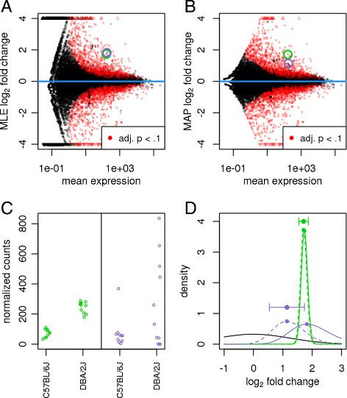
Estimating fold changes between conditions
Genes with low counts have much more variability and get over-estimated fold changes
Empirical Bayes Shrink log2FC based on log2FC of all genes
Low counts
More dispersion
Few samples

Slide 13
Estimating fold changes between conditions
Genes with low counts have much more variability and get over-estimated fold changes
Empirical Bayes Shrink log2FC based on log2FC of all genes
Low counts
More dispersion
Few samples

Slide 14
Differential expression testing
Wald’s test:
Shrunken Log2 Fold Changes / standard error = z-statistics
Adjusted p-values: correct for multiple testing!
Benjamini-Hochberg
What does a significant p-value mean?
P-values depends on sample size and other technical aspects in addition to biology
Every experiment is different! What is a reasonable p-value threshold?
Statistical vs biological significance
E.g. Small p-value, but very small fold change between conditions.. ?
No stat significance = no biological significance?
Look at overall pathways or related genes (E.g. Log2 FC of all genes in set shifted?)

Slide 15
Downstream..
What does it mean?
What type of genes are significantly changed?
GO terms (Panther DB)
Pathways
Biological process
Mol. Function
Cellular compartment
Gene set enrichment analysis (GSEA)
Protein-protein interactions (PPI)
Networks
Correlate with additional data
ATAC-seq, ChIP-seq for histone marks/pol-II

Slide 16
Exam
GO term analysis
Find what GO terms are enriched among significantly changed genes
1. Gene set: Sign.up genes
2. Background list: All genes expressed in your sample
3. Run Panther DB enrichment test

